Slide 1
Implying volatility from prices
Emma Li

Slide 2
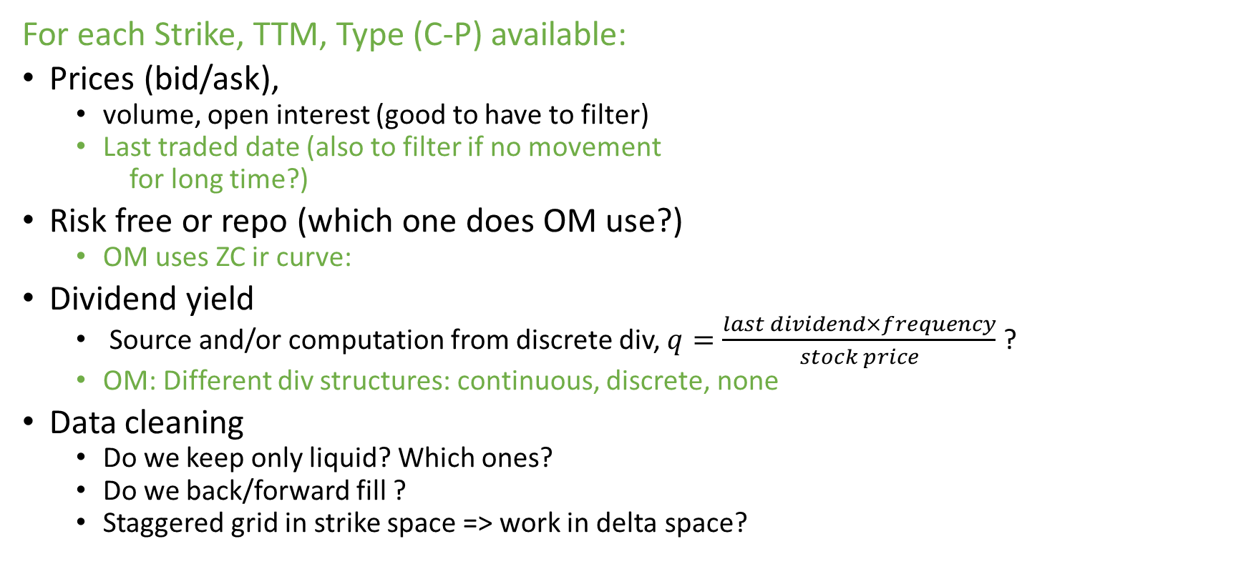
Data input
For each Strike, TTM, Type (C-P) available:
Prices (bid/ask),
  volume, open interest (good to have to filter)
  Last traded date (also to filter if no movement
  for long time?)
Risk free or repo (which one does OM use?)
  OM uses ZC ir curve:
Dividend yield
  Source and/or computation from discrete div, $q=\frac{last dividend×frequency}{stock price}$ ?
  OM: Different div structures: continuous, discrete, none
Data cleaning
  Do we keep only liquid? Which ones?
  Do we back/forward fill ?
  Staggered grid in strike space => work in delta space?
From Doc: Each of the option pricing models used by IvyDB requires a continuously-compounded interest rate as input. This interest rate is calculated from a collection of continuously-compounded zero-coupon interest rates at various maturities, collectively referred to as the zero curve. The zero curve used by the IvyDB option models is derived from ICE IBA LIBOR rates and settlement prices of CME Eurodollar futures. Then, they describe the algorithm

Slide 3
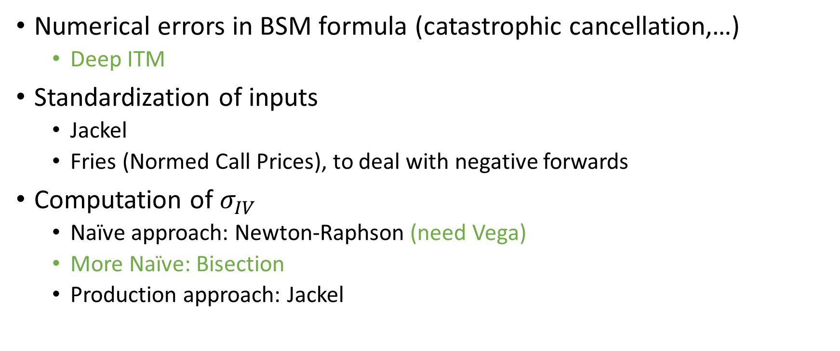
European option Inversion (BSM case)
Numerical errors in BSM formula (catastrophic cancellation,…)
  Deep ITM
Standardization of inputs
  Jackel
  Fries (Normed Call Prices), to deal with negative forwards
Computation of $σ_{IV}$
  Naïve approach: Newton-Raphson (need Vega)
  More Naïve: Bisection
  Production approach: Jackel

Slide 4
American option Inversion
What model to use?
  Closed-form: BAW, Bjerksund-Stensland,…
    Any numerical issues? Convergence ? Speed?
  Trees (Chen-Joshi tree, Modified JZ,…?, Leisner Reisner)
  PDEs
  Monte-Carlo
  Fast AO (Andersen): already implemented in AxR (Zheng)
  Time critical AO Pricing

Slide 5
Interpolation/Extrapolation of IVS
Splines approach:
  Local vs nonlocal: local better for stress testing and no propagation of errors
  Shape-preserving: convexity, concavity
  Arbitrage-free approaches
OM: Kernel Smoothing
(semi) Parametric approaches
  SVI, polynomial in (K,T) used in risk
PDE approach (see work done by Zoe)

Slide 6
Derived quantities
Should be generic to be used with any smile
  Local volatility from Dupire equation
  PDFs from interpolated smile
  Others ???
  Greeks?
Tests:
  Sanity checks
  Put-Call Parity
  Arbitrage free
  Shape

Slide 7
Code design
Decoupled components/abstractions
  Data cleaning
  BSM computation avoiding numerical errors (AxR math layer)
  Normal CDF inversion (AxR math layer)
  IV implication (AxR math layer)
  IVS interpolation (Can this be generic?) (AxR math layer?)
  Derived quantities (local vol, PDF,…)

